Slide 1
Week 1
Entity Relationship Diagrams – REPRESENTING RELATIONSHIPS – Part 3

Slide 2
Student Objectives
Upon completion of this video, you should be able to:
Define the following terms: Relationship, Cardinality, Unary Relationship, Binary Relationship, Ternary Relationship, One to One Relationship, One to Many Relationship, and Many to Many Relationship and give an example of each
Using lines, diamonds and text, indicate the above relationships on an ER diagram
Determine if a relationship has any associated attribute(s)
Represent relationship attributes on an ER diagram

Slide 3
What are we missing from our Model? What haven’t we represented yet?
Look again at our case study, what are we missing from our ER diagram?

Slide 4
Case Study – Creating an ER Diagram
Suppose we plan to model a company which is organized into departments.
Each department has a unique name, number and employee who manages it (we want to keep track of when the employee started managing the department)
A department may have several locations
A department controls a bunch of projects, each project has a unique number, name and a single location
Each employee has a name, ssnumber, address, salary, sex and birthdate
An employee is assigned to only one department but may work on several projects which are not necessarily from the same department
Keep track of the number of hours each employee works on each project.
Keep track of the direct supervisor of each employee
Keep track of the dependents of each employee (name, sex, birthdate and relation)

Slide 5
E-R Model Concepts AND KEY TERMS
Relationship – a named grouping of entities
Relationship Set – an ordered list of entity sets
A Relationship Type R among n entity types E1, E2, … En defines a set of associations among entities. Thus R is a set of relationship instances ri, where each ri associates n entities (e1, e2, ..., en) and each entity ej in ri is a member of entity type Ej, 1<=j<=n. Hence a relationship type is a mathematical relation on E1, E2, ... En.
Example: (“Reid”, “CS3319”) is a relationship set of (Prof, Course)

Slide 6
e.g. The Relationship: Employee WORKS FOR Department
Employee
WORKS FOR
Department
Laura
r1
Roberto
r2
Math
e3
r3
Computer Science
e4
r4
English
…
…
…
QUESTION: In the above diagram, how many entity types participate in the relationship?
Notes:
Two

Slide 7
Binary Relationship - Example
CourseNum
SNum
Course
takes
Student
CourseName
SName
Grade

Slide 8
Degree of a Relationship: Binary, Ternary, Unary
Unary
Relationship
SName
Quantity
Supplier
Project
Supply
Ternary Relationship
ProjName
Part
manages
Employee
PartNo
SSN

Slide 9
More Terminology
Recursive (Unary) Relationship: an entity of one entity type has a relationship with other entities of that same entity
Attributes on Relationships: Describes some piece of information about the relationship. E.g. → Quantity see above
Cardinality Ratio: number of relationships instances that an entity can participate in, there are 3 common ones:
One-To-One: Employee Manages Department
Many-To-One: Employee Works_For Department
Many-To-Many: Employee Works_On Project
QUESTION: What is the cardinality of: Man BIOLOGICALLY FATHERS Child?
QUESTION: Give an example of a many to many relationship:
Notes:
Man fathers child → 1 to Many
Many to Many → Sister has Brother

Slide 10
Draw the following Relationships as they would be represented in an ER Diagram:
An artist paints paintings
A person owns pets
A woman is currently married to a man (and show the date they got married) and a woman has been married to a man (show the date they got married and the date the marriage ended).
Wedding Date
1
1
Currently Married to
Woman
1
1
Man
Wedding Date
Artist
1
paints
M
Painting
Person
owns
1
Was Married to
Pet
M
M
Marriage End Date
N
M
M

Slide 12
E-R Diagram Notation So Far:
Relationship Type
Relationship Attribute
Cardinality
1
M

Slide 13
QUESTION: What are the Relationships from our example?
Notes:
Department
Employee
Dependent
Project

Slide 14
Case Study – Creating an ER Diagram
Suppose we plan to model a company which is organized into departments.
Each department has a unique name, number and employee who manages it (we want to keep track of when the employee started managing the department)
A department may have several locations
A department controls a bunch of projects, each project has a unique number, name and a single location
Each employee has a name, ssnumber, address, salary, sex and birthdate
An employee is assigned to only one department but may work on several projects which are not necessarily from the same department
Keep track of the number of hours each employee works on each project.
Keep track of the direct supervisor of each employee
Keep track of the dependents of each employee (name, sex, birthdate and relation)

Slide 15
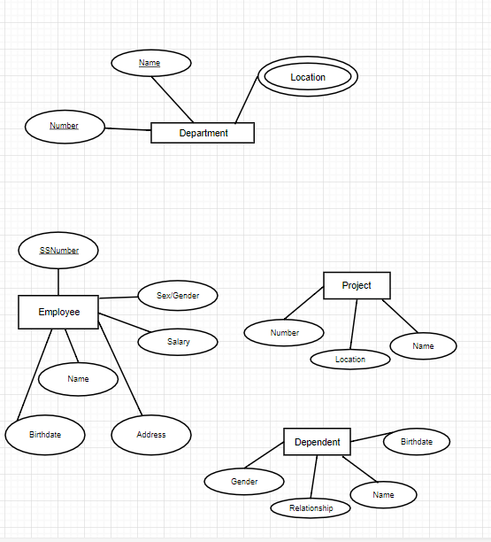
QUESTION: What is our diagram so far? (It is started below)
Let’s use draw.io to finish the diagram.

